Slide 1

WorldPortal Book Recommendation App for Fantasy Readers Metis Project 4 Rebecca Riso

Slide 2

Motivation
Never be stuck in reality
Goodreads not sufficient
Large genre with sub-genres
Objective
Recommendation app for fantasy book readers
Hybrid approach

Slide 3
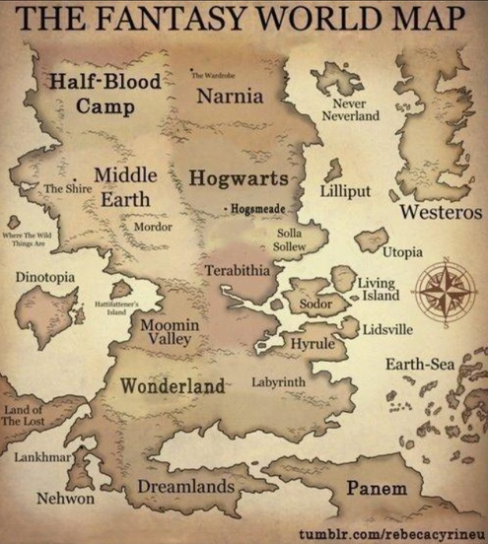
1 Sub-genres in Fantasy NLP and Topic Modeling with Spacy & gensim Lemmatization | Nouns | LDA model (5 topics)

Slide 4





Young Adult
love | family | man | girl | woman | heart | mother | school | father | night | friend
Epic Fantasy / Fairytale
magic | king | land | fantasy | prince | queen | dragon | adventure | power| quest
Supernatural / Vampire Romance
war | vampire | man | power | blood | death | battle | heart | enemy | love | demon
Science Fiction
earth | planet | science | history | work | award | space | century | war | universe | future
Urban Fantasy/ Zombie / Thriller
city | man | killer | murder | death | job | zombie | case | team | police | mystery | government

Slide 5
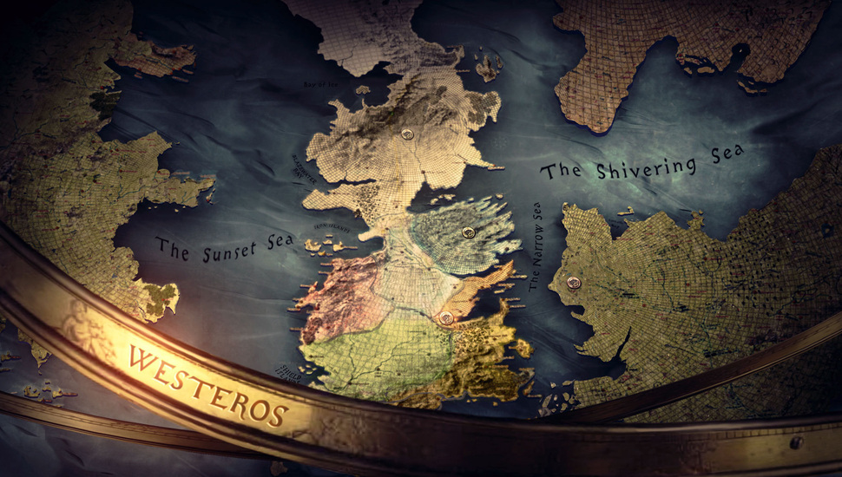
Item similarity
Sklearn
Cosine similarity
Matrix of 5 topic weights

Slide 6

Data: BeautifulSoup/ Mongodb
40k books/6k users
Recommendation algorithms: Surprise

Slide 7
User rating estimation using surprise prediction algorithms
Algorithm | MAE
SVD | 0.656
KNNWithZScore | 0.659
KNNBaseline | 0.662
KNNWithMeans | 0.663
CoClusering | 0.691
KNNBasic | 0.729
NormalPredictor | 1.043
Final predictor: SVD algorithm | 50 epochs | 0.008 learning rate |0.1 regularization | 100 factors | 0.656 MAE

Slide 8
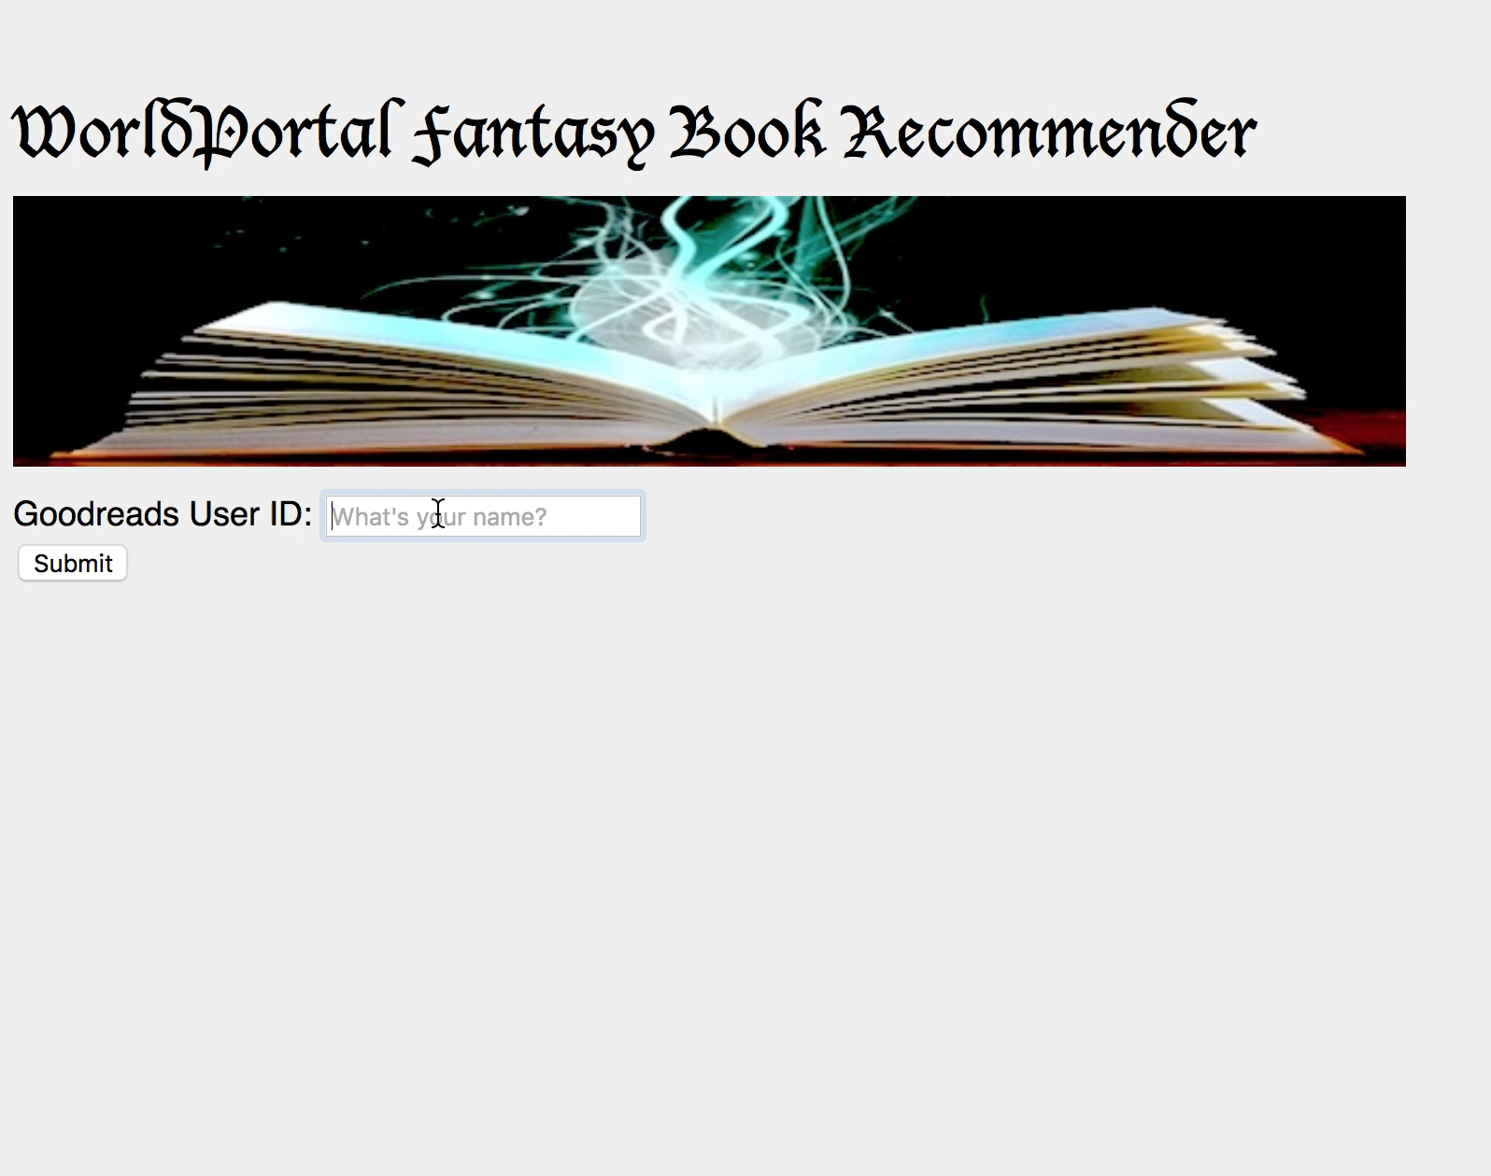

Slide 9
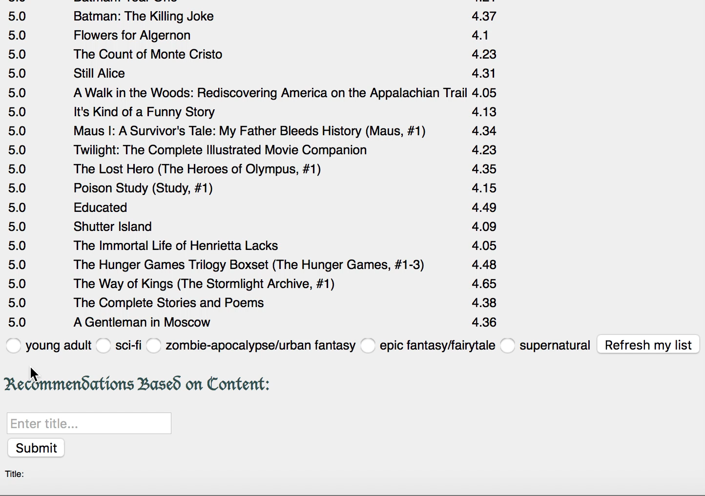

Slide 10

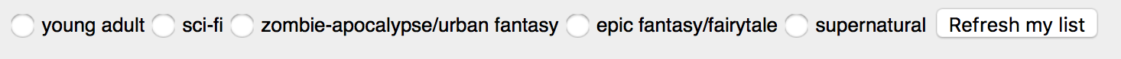
Future Work
Additional users to improve rating estimates
Collaborative/content hybrid approach
Improved similarity approach (entire text?)

Slide 11
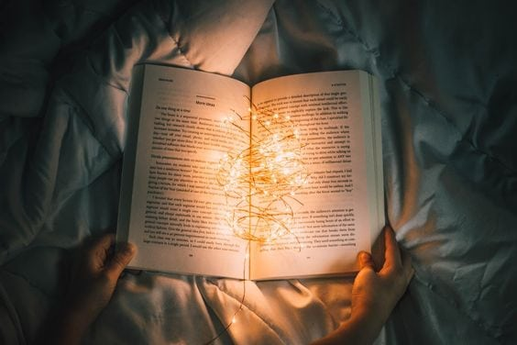
QUESTIONS

Slide 12
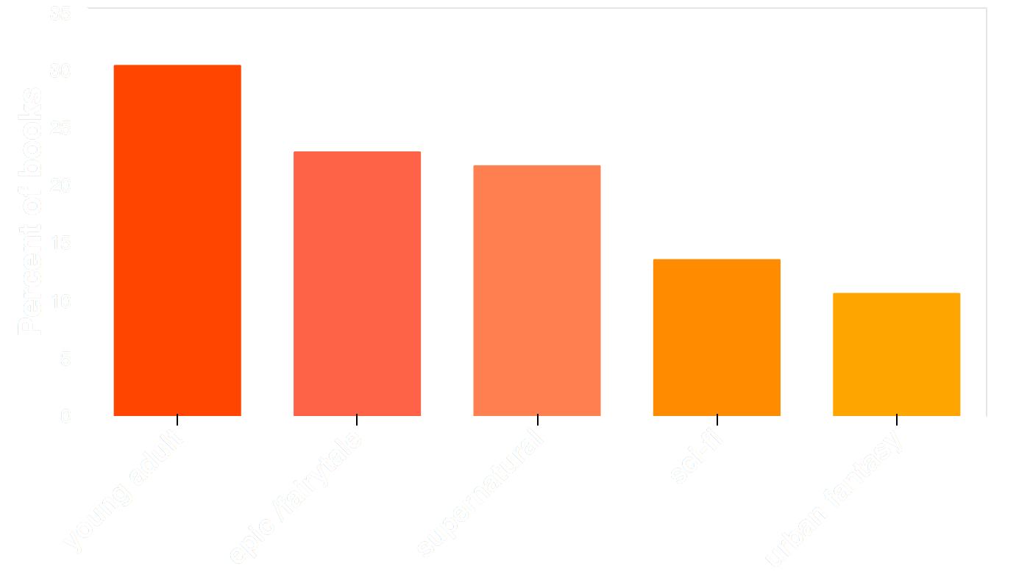
Distribution of sub-genres

